Slide 1

A Compassionate Response to Crisis
Dave Andrews
Associate Director of Employee Wellness

Slide 2
Goals of the day
Cover resources
Explore the body’s response to crisis situations
Learn
  De-escalation techniques
  Crisis listening skills
  Effective ways to offer support
Apply skills to real-world situations

Slide 3

Norms for our time together
Take care of yourself as we go
If you are not sure the “right way” to ask a question, please ask it however you can
Please do not share specific details of a situation that could identify someone
Be mindful of content that could be triggering

Slide 4
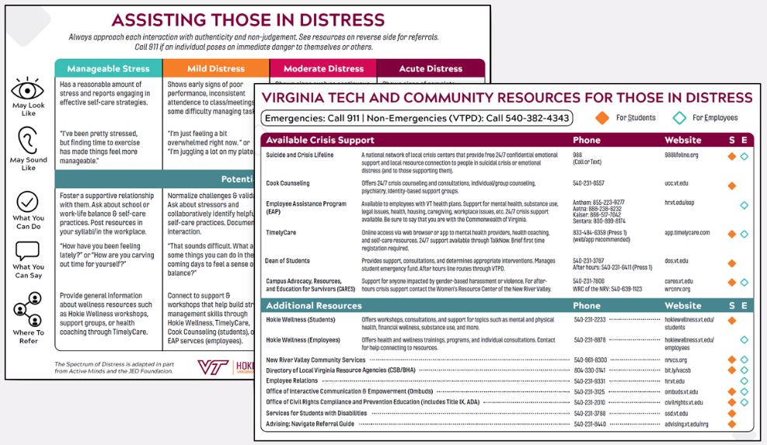

Slide 5
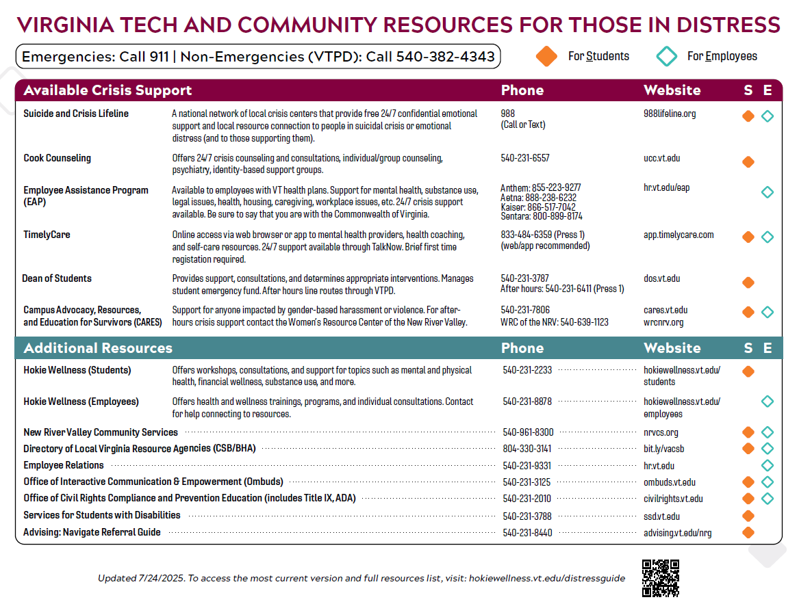

Slide 6
Activity Sheet
Complete Columns 1 and 2
What types of student/employee crisis situations have you faced, or do you worry about facing?
What are your fears or barriers to being supportive in these situations?

Slide 7
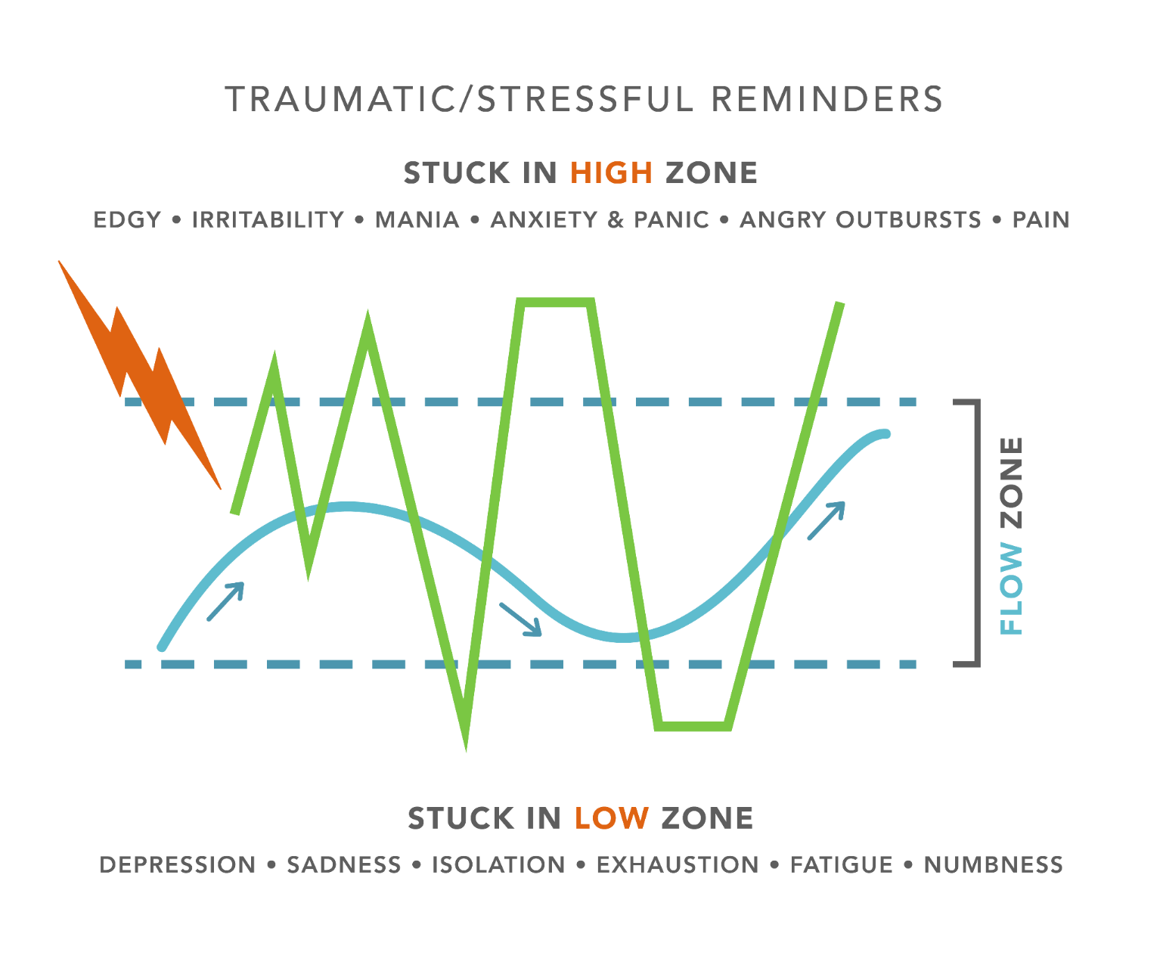

Slide 8

Tracking the Autonomic Nervous System
Parasympathetic
Prepares for Rest
Sympathetic
Prepares for Action
The PNS controls the body
during rest
Breathing rate
Heart rate
Pupils Constrict
Blood Pressure
Sweating
Stress Hormones
Digestion
Saliva
The SNS controls organs during times of stress
Breathing rate
Heart rate
Pupils Dilate
Blood Pressure
Sweating
Stress Hormones
Digestion
Saliva

Slide 9
Activity Sheet
Complete Column 3
What do you/might you notice about your body in these situations?

Slide 10
Activity Sheet
What strategies do you use to calm yourself in stressful situations?

Slide 11
Activity
How can we support others going through the situation?

Slide 12
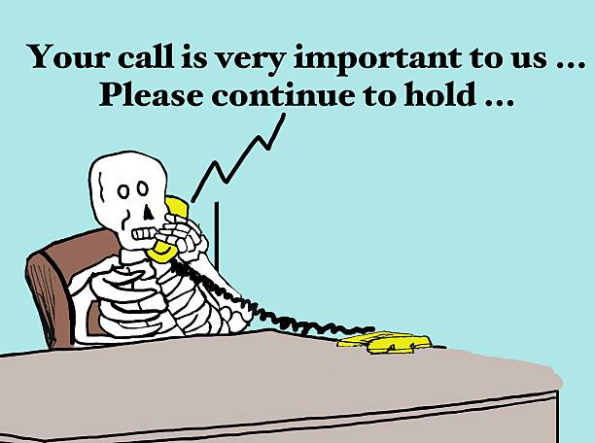
Activity
How can we support others going through the situation?

Slide 13


De-escalation techniques
Speak slowly and confidently with a gentle, caring tone of voice.
Do not argue or challenge the person.
Do not threaten.
Do not raise your voice or talk too fast.
Use positive words instead of negative words.
Stay calm and avoid nervous behavior.
Do not restrict the person’s movement.
Try to be aware of what may increase the person’s fear and aggression.
Think about how your unintentional bias may be playing into the situation (culture, identity, etc.).
Pause, if needed, during the conversation.
NOTE: Must ensure safety for all involved

Slide 14

Crisis Listening
Never stop assessing the situation
Be curious
  Listen to learn not to solve
  (2 minute rule)
  Listening to learn is not interrogating
Be empathetic
  Try to understand how they feel.
  This does not mean agreeing or disagreeing.
NOTE: Be mindful of when you need to refer

Slide 15

Notes:
https://www.youtube.com/watch?v=1Evwgu369Jw

Slide 16
Activity Sheet
Complete Column 4
What de-escalation or listening skills could you practice?

Slide 17

Now we can talk about offering support
Maintain their autonomy
Focus on one thing at a time (you and the individual)
  If the fear is next week, then focus on immediate steps
Explore realistic options
  what is possible? – respect your own boundaries, and validate their need
Offer options for resources/supports
  Are they safe and accessible?

Slide 18
Activity
Customer service call. This time the customer service rep is going to use de-escalation skills while being curious and empathetic.

Slide 19

Important Considerations
Before offering your support (in non-emergency situations)
  Do you have the time?
  Do you have the capacity?
  Are you the right person?
    Power dynamics
    Seen as safe?
Have identified supports for you

Slide 20
Activity Sheet
Complete Column 5
How can you provide support and what recourses might you offer?

Slide 22
Additional Resources
CRM
https://ucc.vt.edu/outreach_consultation/crm.html (more info/videos)
https://virginiatech.pageuppeople.com/learning/10662 (self-passed training)
Mental Health First Aid
https://virginiatech.pageuppeople.com/learning/7927
Hokie Wellness for Employees
hokiewellness.vt.edu | 540-231-8878 | hokiewellness@vt.edu

